Slide 1
Structure
Rakib Mahmud

Slide 2
Introduction
All the elements stored in an array should be of the same data type.
If we need to use a collection of different data type items, it is not possible using an array.
That’s where structures are there to rescue you!.
Basically, structure groups different variables together.
So, Structure is a collection of variables of different types under a single name.
Structure is a user defined data type.

Slide 3
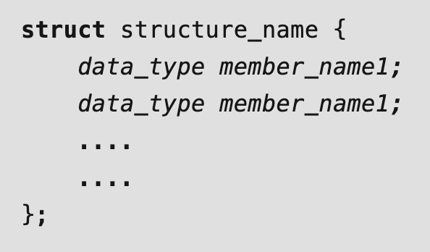
Syntax with Examples
Examples
struct person {
char name[20];
float salary;
int age; };
Above one is template or blue print. In here, name, age, salary are the
members of structure.

Slide 4
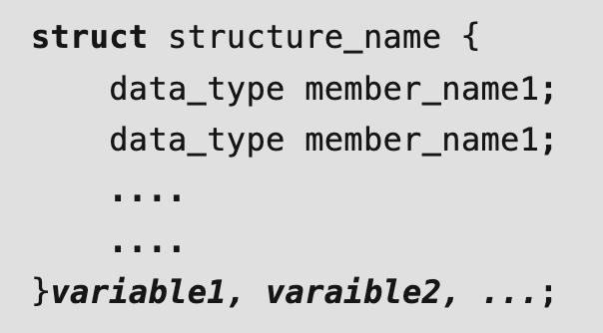
Structure Variable Declaration with Structure Template
struct person {
char name[20];
float salary;
int age; }Person1, Person2, Person3;
Person1, Person2, Person3 are structure variables
Person1
Person2
Person3
char name[20];
float salary;
int age;
char name[20];
float salary;
int age;
char name[20];
float salary;
int age;

Slide 5
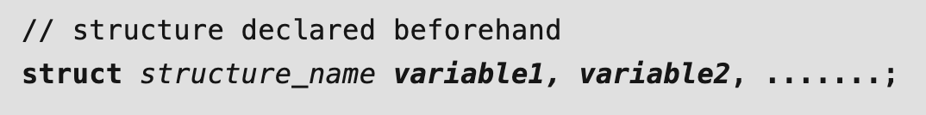
Structure Variable Declaration after Structure Template
struct person {
char name[20];
float salary;
int age; };
struct person Person1, Person2, Person3;
Person1, Person2, Person3 are structure variables
Person1
Person2
Person3
char name[20];
float salary;
int age;
char name[20];
float salary;
int age;
char name[20];
float salary;
int age;

Slide 6
Accessing Members of a Structure
There are two types of operators used for accessing members of a structure.
. Member operator
-> Structure pointer operator (will be discussed later)
struct person {
char name[20];
float salary;
int age; };
Suppose, you want to access the salary of person2. Here's how you can do it.
person1.salary
struct person person1;
Notes:
“->” This sign is known as arrow operator in C/C++

Slide 7
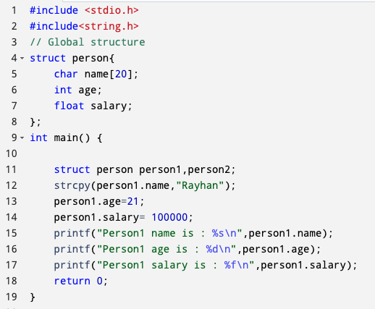
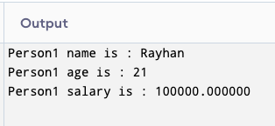
Example of Structure in C

Slide 8
Local Vs Global Structure
A local structure is defined inside a function or a block of code, and it can only be accessed within that function or block of code.
A global structure is defined outside a function or a block of code, and it can only be accessed all over the program.

Slide 9
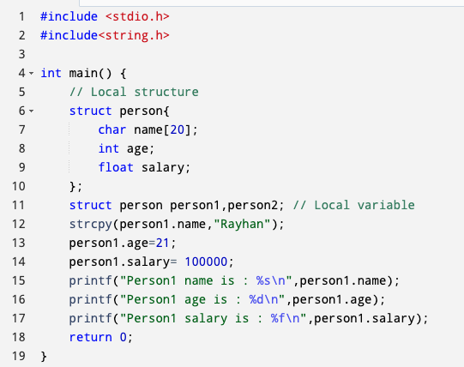
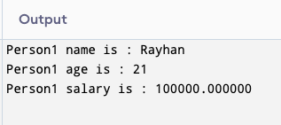
Example of Structure in C (Cont’d)

Slide 10
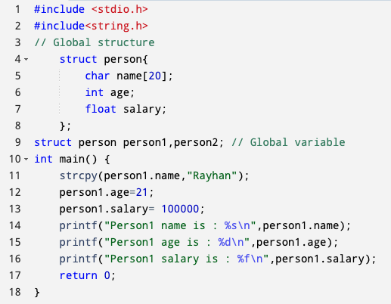
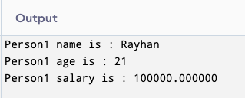
Example of Structure in C (Cont’d)

Slide 11
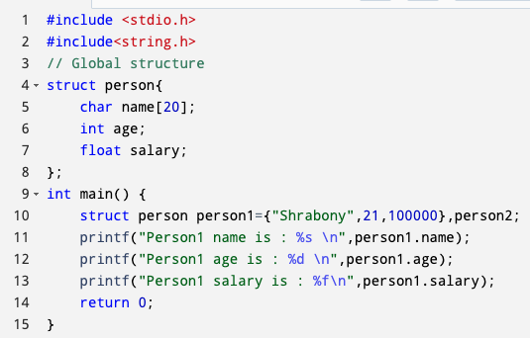
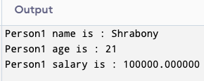
Initialize Structure Variables

Slide 12
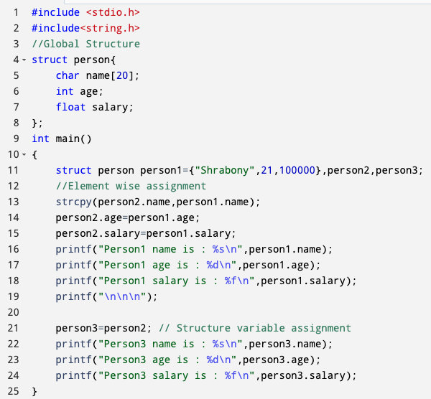
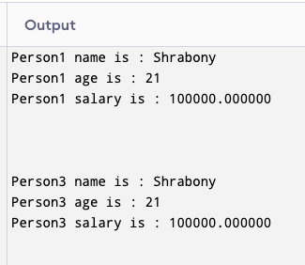
structure handling and assignment in C

Slide 13
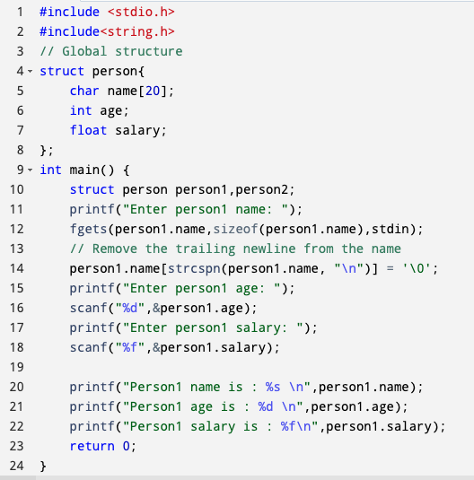
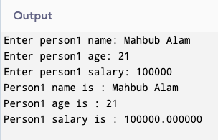
Input structure element

Slide 14
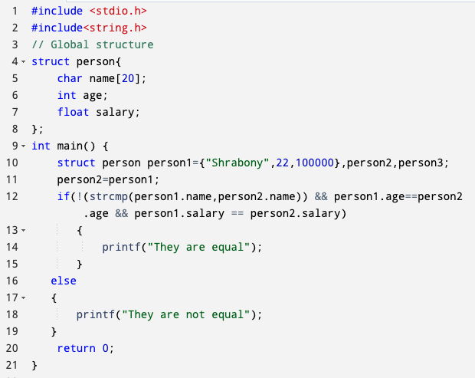
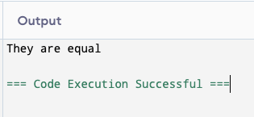
Structure Comparison

Slide 15
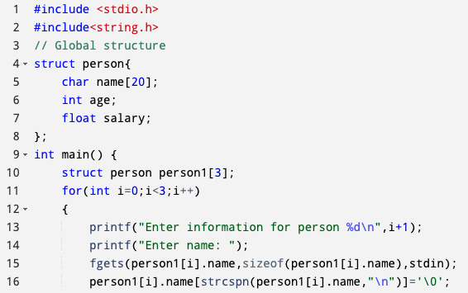
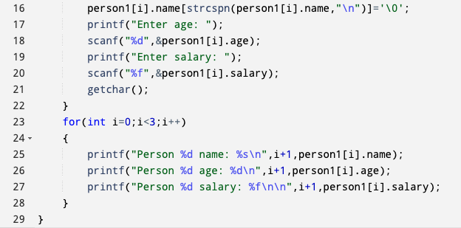
Array of Structure
Notes:
When you call scanf() for consecutive inputs (e.g., integers or floats), scanf() skips any whitespace (including the leftover newline) and waits for the next valid input.
fgets() does not skip whitespace or leftover characters in the input buffer. So, if there’s a newline left by scanf() and you then call fgets(), it will read that newline as input.
Here, getchar() is needed to consume the leftover newline before calling fgets().

Slide 16
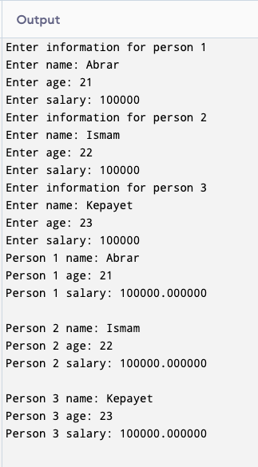
Array of Structure

Slide 17
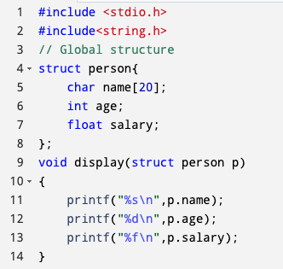
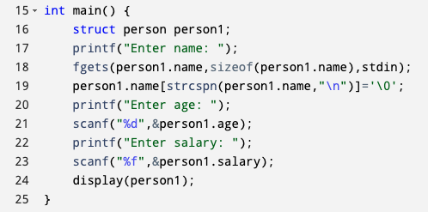
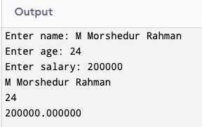
Passing Structure Variable to Function

Slide 18
Structure Pointer in C
We can define a pointer that points to the structure like any other variable.
Such pointers are generally called Structure Pointers.
We can access the members of the structure pointed by the structure pointer using the ( -> ) arrow operator.

Slide 19
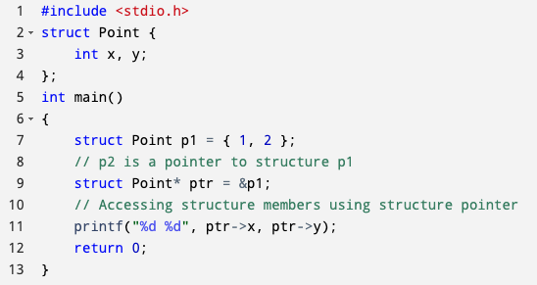

Structure Pointer in C

Slide 20
Thank You

